Slide 1

Subsidizing Small Modular Reactors
Autumn Hanna Senior Program Director
Notes:
Add logo to slide

Slide 2
Taxpayers for Common Sense
Taxpayers for Common Sense is an independent and nonpartisan voice for taxpayers working to increase transparency and expose and eliminate wasteful and corrupt subsidies, earmarks, and corporate welfare.
Oversight of the federal budget – legislative tracking and analysis, investigations, and advocacy
Breadth of issues – energy and natural resources, national security, transportation, agriculture, and water resources
Credibility for quality and nonpartisanship with the media and policymakers
Mission and track record that aligns conservatives, moderates, and liberals behind common sense solutions

Slide 3
SMRs get a GOLDEN FLEECE
Senator William Proxmire’s Award given to TCS for projects/programs that are an egregious waste of taxpayer dollars.
Golden Fleece Award for Small Modular Reactors, February 2013 - in an era of fiscal austerity and across the board cuts the new SMRs program still manage to get new $.
Most Famous TCS Fleece: The Bridge to Nowhere, 2003

Slide 4
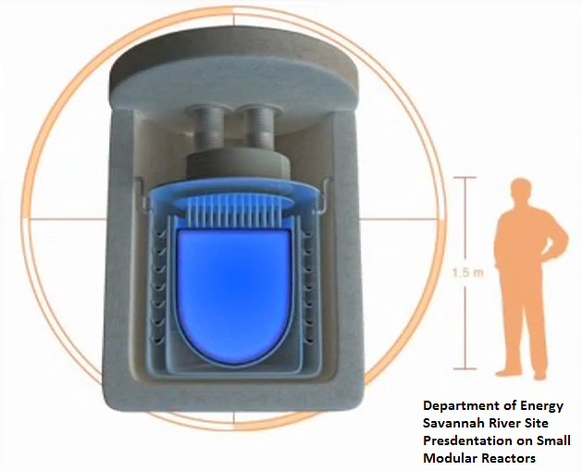
What are SMRs?
Size
Less than 300 MWe
Modular
Factory produced
Manufactured by assembly line
Shipped to final site
Truck, ship, or rail
Coming to your neighborhood soon!

Slide 5
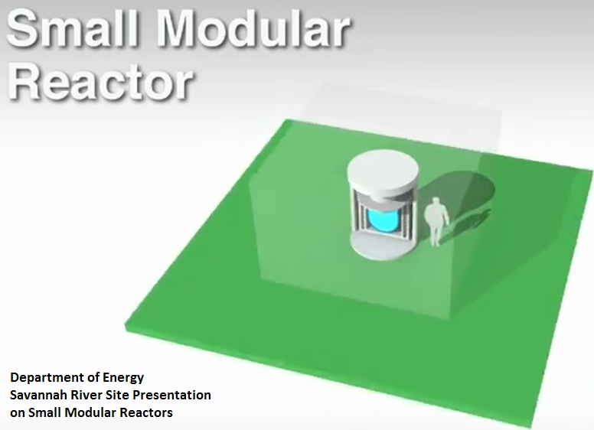
A Terrible Taxpayer Investment
High-risk: transportation, security, insurance
High-cost: $1 billion or more per reactor
Regulatory and safety concerns
Unknown market

Slide 6
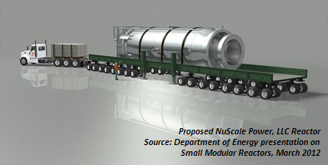
High Cost & High Risk
No reliable costs estimates
Estimates that have circulated in the billions
Approx. $1 billion per 100-150 MWe
As or more expensive than commercial scale reactors
Cost efficiency based on “modular” concept which has major risks and market concerns

Slide 7
High Cost & High Risk
NRC estimated in 2008 to have SMR review process in place by 2013
“If an appreciable fraction of total SMR initiatives materialized, it would create an untenable situation for the NRC.” – NRC, May 2012
Process: Combined process or back to separate design and construction
Liabilities
Decommissioning costs
Annual fees to NRC
Insurance requirements
Safety
Number of control room operators
Size of emergency planning zone
Amount of security
Notes:
Unknowns could cause delay and increased costs or leave abandoned projects and wasted taxpayer dollars

Slide 8
Dept. of Energy Subsidies
Committed $452 million for licensing support between 2012-2017
Annual funding for advanced R&D
Approx. $20-25 million per year
First subsidized through SMR program in 2011
Current FY2014 Budget released this April includes $70 million for licensing support and $20 million for advanced R&D

Slide 9
Dept. of Energy Subsidies
Table 1: DOE Small Modular Reactor Program Funding (millions)
Sub-Program: | FY2011 (ACTUAL) | FY2012 (ACTUAL) | FY2013 | FY2014*
Licensing Support | - | 67 | 67.410 | 70
Advanced R&D | 3.105 | 24.529 | ~24.529** | 20
TOTAL SMR Program | $3.105 | $91.529 | $91.939 | $90
Source: Consolidated Appropriations Act, 2012 (P.L. 112-74) & Congressional Budget Requests *Requested **Final allocations have not yet been determined
Notes:
These numbers have been updated and are not the same as the numbers in our February award backgrounder.

Slide 10
Licensing Subsidies
Administration has committed $452 over 6 years
Energy Department will support the design certification & licensing of up to two SMR designs
Taxpayers provide up to 50% of project costs
SMR Licensing Technical Support
FY2012: $67 million
FY2013: $67.41 million
FY2014 Request: $70 million
Notes:
Federal SMR program was a five-year program initially. DOE extended the program to six years after receiving lower than expected appropriations during the first two years of the program.

Slide 11
Research and Development Subsidies
Reactor Concepts Research, Development, and Demonstration Subprogram
Advanced SMR R&D
FY2011: $3.105
FY2012: $24.529
FY2013: ~$24.529 (final allocations TBD)
FY2014 Request: $20 million
Navy: smaller reactors for ships
Army: Nuclear Power Program
DOE: Nuclear Energy Research Initiative

Slide 12
Current Applicants
Five applications in total
Table 2: Active Small Modular Reactor Projects at the Department of Energy
Company Name | Reactor Capacity (MWe) | Reactor Type | SMR Funding Applicant | SMR Funding Recipient | Savannah River Site Partnership Recipient | Location
Westinghouse Electric Company | 225 | iPWR | X |  |  | Ameren Power’s Callaway Site, MO
Babcock & Wilcox Company* | 180 | iPWR | X | X |  | Tennessee Valley Authority’s Clinch River Site, TN
Holtec International Incorporated | 145 | iPWR | X |  | X | Department of Energy Savannah River Site, SC
Fluor Power Corporation | 45 | iPWR | X |  | X | Department of Energy Savannah River Site, SC
Gen4 Energy | 25 | FNR |  |  | X | Department of Energy Savannah River Site, SC
*Announced in November 2012

Slide 13

First Subsidy Award
Generation mPower LLC selected as first recipient of federal cost-share funding in November 2012
Jointly-owned subsidiary of Babcock & Wilcox Nuclear Energy Inc. and Bechtel Power Corporation
Location: Tennessee Valley Authority’s (TVA) Clinch River site, TN
Reactor Type: 180 Mwe iPWR*
Project operating date: 2022
Contract with TVA to prepare NRC construction permit application
*iPWR: Integral pressurized light water reactor

Slide 14
New Solicitation
Dept. of Energy announced March 2013
Second half of the original $452 million
To support the commercialization of one additional SMR design by 2025
Taxpayers to provide up to 50% of project costs
Applications due: July 1, 2013
Notes:
Solicitation adds that commercialization could also be as late as 2027—five years after the first round proposes to reach commercial operations in 2022.

Slide 15
Future Taxpayer Concerns
Stop Corporate Welfare
Private Industry should pay
Hot-tub sized reactors… king-sized costs
Unknown regulatory requirements
Price Anderson
Future Subsidies:
Freestanding Legislation
Energy and Water Appropriations

Slide 16

Autumn Hanna
Senior Program Director
202-546-8500 x112
autumn@taxpayer.net
www.taxpayer.net

