Slide 1
Royalty Policy Committee – Planning, Analysis & Competitiveness Subcommittee –Nov. 17, 2017
Presentation on IHS-CERA study and subsequent studies
Radford Schantz (BOEM)
Sarah Peters (BOEM)

Slide 2
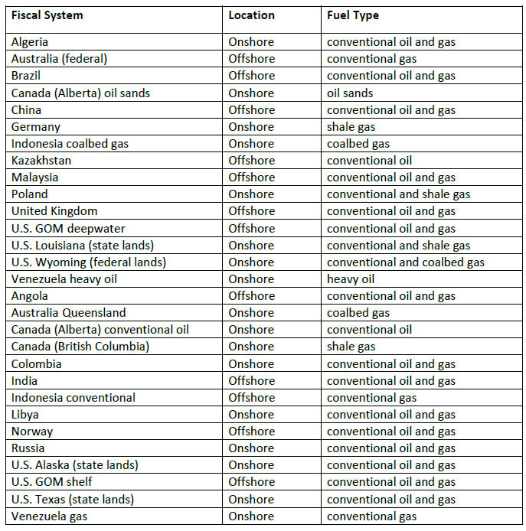
IHS-CERA 2011
Fiscal Regimes Included in Comparative Analysis

Slide 3
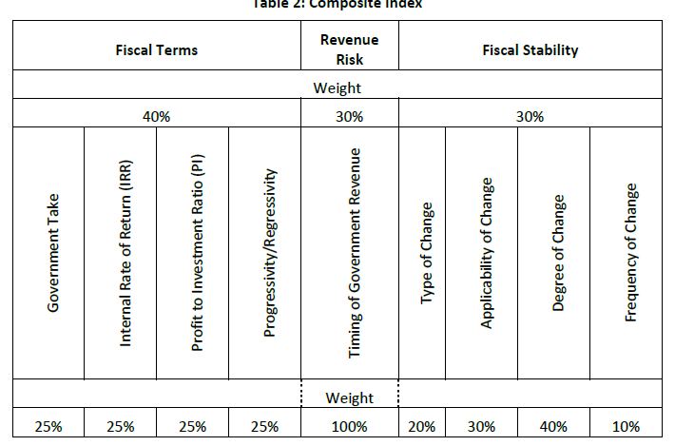
IHS-CERA 2011
Comparative Indicators

Slide 4
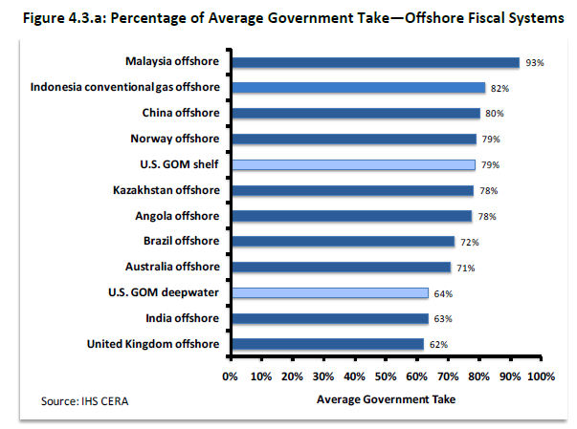
IHS-CERA 2011
Comparison of Gov’t Take: Offshore Group
… a similar chart was published for the onshore group

Slide 5
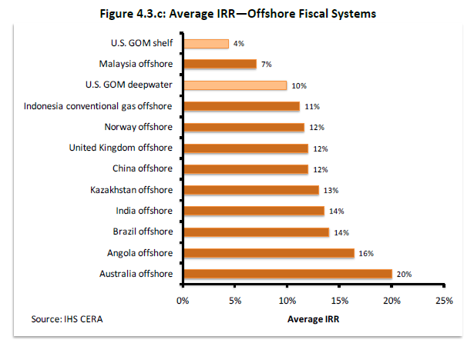
IHS-CERA 2011
Comparison of Profitability (IRR): Offshore Group
… a similar chart was published for the onshore group

Slide 6
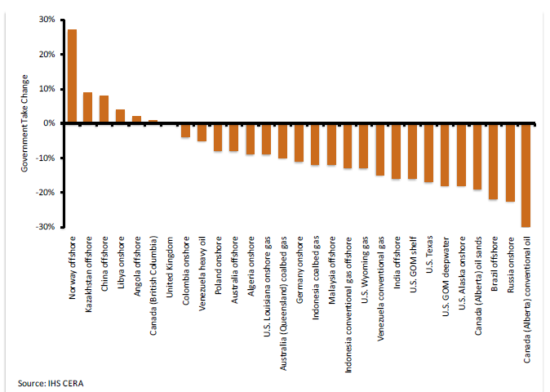
IHS-CERA 2011
Progressivity (Avg. Change in Gov’t Take for a 20% Increase in Profitability)
… For a decrease in profitability, flip the chart!

Slide 7
A Competitiveness Review is Effective When…
The peer group has been properly identified
  Do the jurisdictions compete with each other for investment?
  Similar type of resources, costs
  Similar investors, global vs. small regional investors
Actual finding and development costs are used
There is a realistic perception of the resource potential
Market analysis is included … Where investments are going

Slide 8
Studies Done Since 2011
GlobalData-BOEM Comparative Studies Since 2011
BOEM began contracting studies targeted at specific comparisons in 2015
  Mexico Round One Report, GlobalData, 2015
  Analysis on Government Responses to Low Oil Prices, GlobalData, 2016
Quarterly Bid Round Reports, GlobalData

Slide 9
Some Other Large Studies Since 2011
Government Fiscal Strategies under Low Oil Prices and Climate Change. 3rd Government Oil and Gas Summit, March 1, 2016. Pedro van Meurs
Flexible Gross Split Sharing: A new fiscal model for the upstream petroleum industry, May 2017. Van Meurs Energy
Fiscal systems for oil in North America, Wood Mackenzie, 2016

Slide 10
Some Country-specific Studies Since 2011
Driving investment: a plan to reform the oil and gas fiscal regime, UK Treasury, 2014; also, Scotland’s Independent Expert Commission on Oil and Gas: Maximising the Total Value Added, 2014
Review of Ireland’s Oil & Gas Fiscal System, Wood Mackenzie, 2014
Licensing and Upstream Petroleum Fiscal Regimes: Assessing Lebanon’s Choices, Carole Nakhle, 2015
The Optimal Petroleum Fiscal Regime for Ghana: An Analysis of Available Alternatives, Dankwa Kankam and Ishmael Ackah, International Journal of Energy Economics and Policy,Vol. 4, No. 3, 2014
Comparative Analysis of Upstream Petroleum Fiscal Systems of Three Petroleum Exporting Countries: Indonesia, Nigeria and Malaysia, Babajide et al, 2014
Mexico Round 1 Fiscal Terms: The Incentive for Gold Plating, Van Meurs, 2015
…and more!

Slide 11
On-going Information Services
https://www.woodmac.com/news/editorial/petroleum-fiscal-systems-insight/
https://www.globaldata.com/store/report/ [quarterly round reports]
https://www.palantirsolutions.com/palantir-regime-library-prl-country-analysis/ See also, Practical Petroleum Economics and Fiscal Regimes, Hawkins, 2016
Ernst & Young. “Global oil and gas tax guide”,
https://vanmeursenergy.com/...the Legal Database

