Slide 1

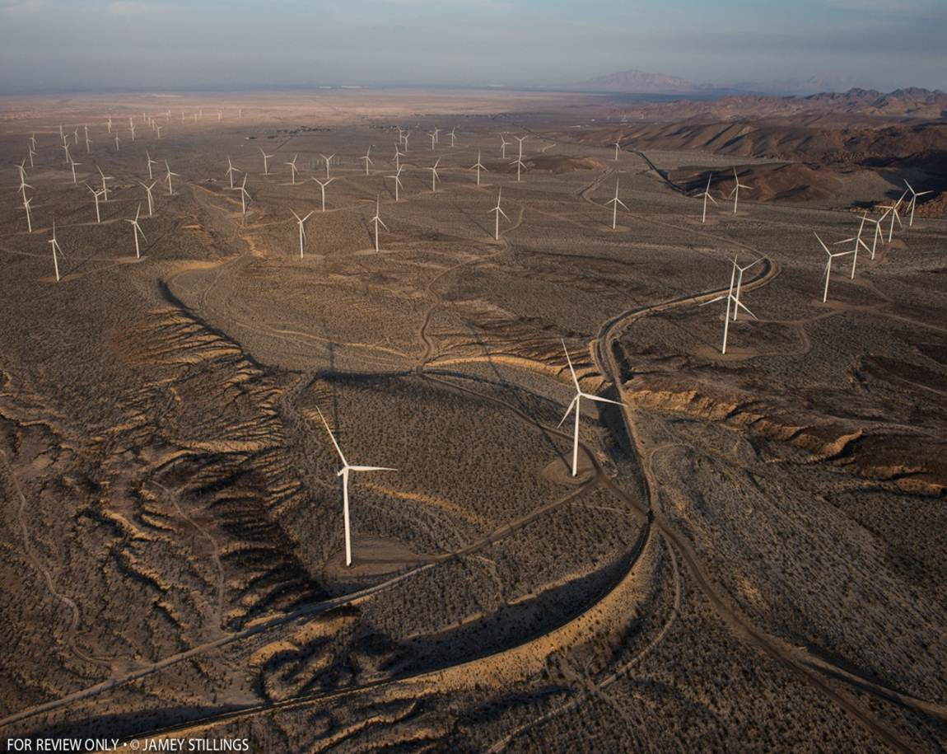
BLM Wind Energy Program
January, 2018
Supporting Text

Slide 2
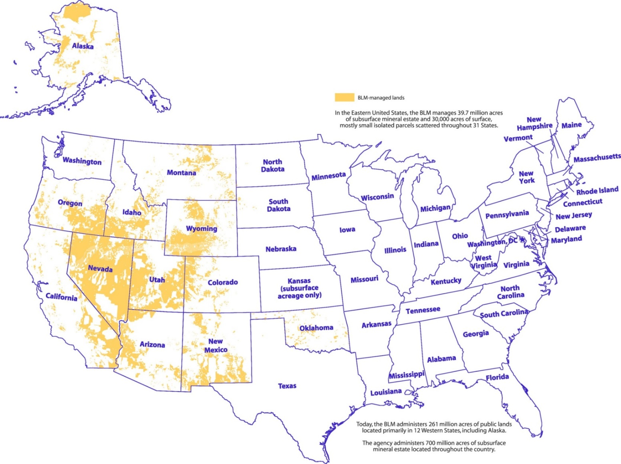
BLM Public Surface: 248 million acres

Slide 3
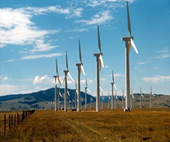
Wind Energy Program
40 Approved Projects
5,608 MWs installed capacity;
Annual Revenue = $4.5M+ per year
Distribution of Projects
Arizona - 2
California – 27
Idaho – 1
Nevada – 3
Oregon – 3
Utah – 2
Wyoming - 2

Slide 4

Authorization Process: Wind Projects
New Competitive Wind and Solar Rule*
  Effective January 18, 2016
  Identification of Designated Leasing Areas (DLAs) in land use plans
    Incentives including pre-screening of resource conflicts, development of mitigation strategies and expedited processing;
    Competitive lease sales, lease issuance & development.
  Provides for proposals outside of designated leasing areas
    Allows for competitive process (preferred applicant status);
    Submission of application;
    Analysis, decision & grant issuance.
*Federal Register / Vol. 81, No. 243, December 19, 2016: Competitive Processes, Terms, and Conditions for Leasing Public Lands for Solar and Wind Energy Development and Technical Changes and Corrections

Slide 5
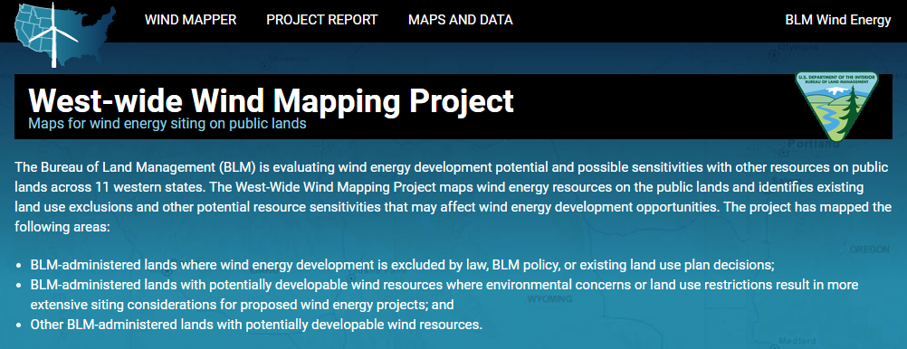
Wind Energy Designated Leasing Areas
Land Use Planning Process
Identification of potential DLAs using mapping tool:
http://wwmp.anl.gov/

Slide 6
Wind Authorization Quick Facts: Leases
  Right-of-way lease in DLA (Lease Award)
    Identify parcels for competitive offer based on nominations and expressions of interest or on agency initiative.
    Notice of Competitive Offer and Lease Award;
    Authorization of wind energy development and ancillary facilities;
    Limited NEPA Review: tiered NEPA (EA/EIS) ;
    30-year term;
    BLM Decision and Notice to Proceed.

Slide 7
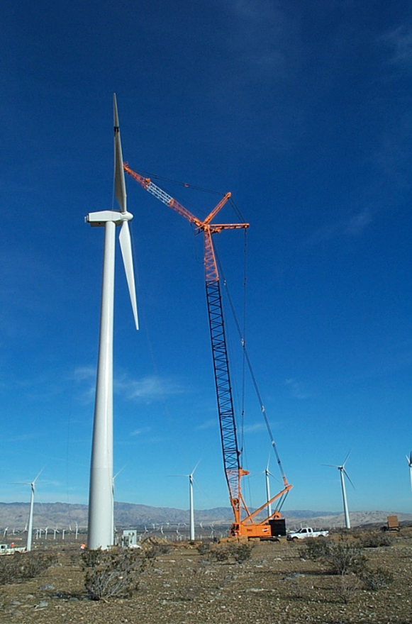
Wind Authorization Quick Facts: Grants
  Right-of-way grant (outside of DLAs)
    Acceptance of Application;
    Preliminary Application Review Process;
    NEPA Review;
    BLM Planning Decision and grant offer;
    30 year term;
    Notice to Proceed.

Slide 8
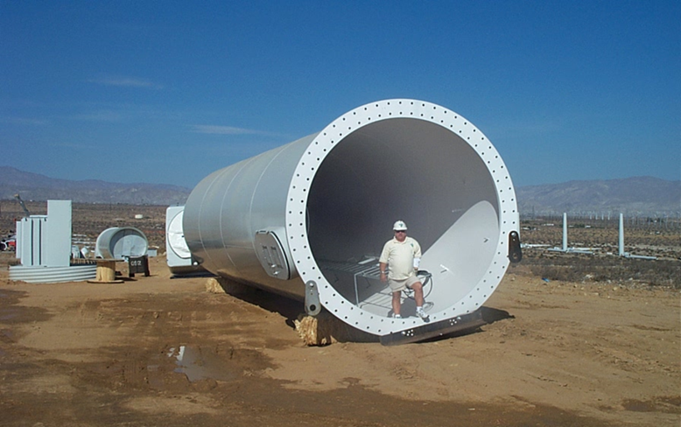
Rents and MW Fees
Annual payment in advance*
Rent calculated using National Agriculture Statistics Service (NASS) data:
  (# acres) X (per acre zone rate based on NASS data) X (land encumbrance factor @ 10%) X (rate of return @ 5.27%) X (annual adjustment factor)
MW capacity fee:
  (8760/year) X (net capacity factor) X (MWh price) X (MW rate of return)

Slide 9
Periodic Adjustments
Acreage rent and MW capacity fees adjust periodically based on identified factors;
  changes in NASS survey values, wholesale power prices & IPD-GDP annual adjustments.
Option to select fixed or scheduled rate adjustments to the applicable per acre zone rate (or rent) and MW rate over the term of the right-of-way grant or lease.
  Option 1 (standard adjustments) - adjust upward or downward with changes in the market once every 5 years for grants and every 10 years for leases.
  Option 2 (scheduled rate adjustments)
    Grant – Annual IPD-GDP adjustments to acreage rate, and 20% increase to the current rates every 5 years;
    Lease – IPD-GDP adjustments plus 40% increase to the current acreage rates every 10 years, and 40% increase to the MW rate every 10 years.

Slide 10

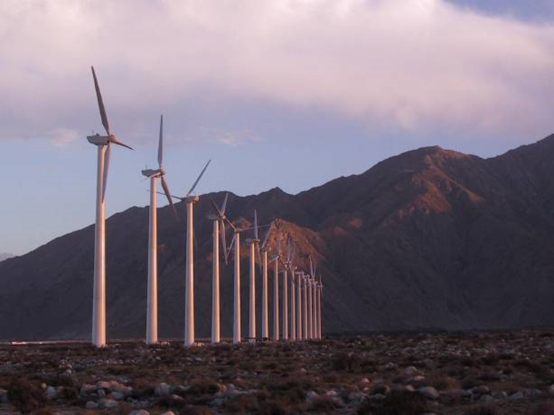
Questions?
Contact:
John R. Kalish, Chief
Office of Renewable Energy Coordination
Bureau of Land Management
20 M Street SE, Rm. 2134LM
Washington DC 20003
202-912-7312 office
jkalish@blm.gov

