Slide 1
Religious Community Support for the BLM Methane Rule
Shantha Ready Alonso
Executive Director
Creation Justice Ministries

Slide 2
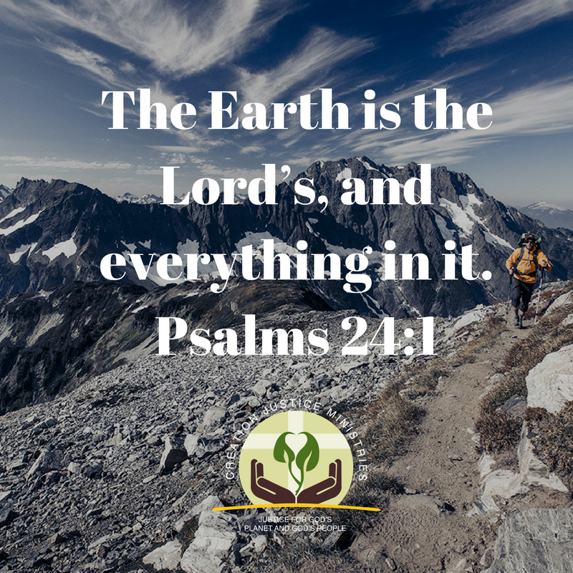
What does stewardship mean to Christians?

Slide 3
Chesie Lee, Executive Director, Wyoming Association of Churches
“In Wyoming, we welcome this opportunity for public dialogue about stewardship of God’s creation, including the finite natural resource of natural gas. Right now, enough natural gas is being wasted annually on America’s public lands to supply the entire state of Wyoming for a year.”
Media Statement, January 22, 2016

Slide 4
Rev. Dr. Donna McNeil, Executive Director, New Mexico Conference of Churches
We welcome the new proposed standards for methane emissions being proposed by the Bureau of Land Management as an opportunity to be better stewards of our natural resources and to care for those whose health is threatened by excessive methane emissions."
Media Statement, January 22, 2016

Slide 5
Rev. David Nichols, Pastor, Mount Tabor Lutheran Church Salt Lake City, Utah
“As Lutheran Christians, we believe that God wants us all to have abundant life, free of sickness and safe from harm’s way.
Solutions that would stop natural gas venting, flaring, and leaking can cut ozone-forming pollutants and toxic chemicals such as benzene that pose a severe threat to the health and safety of Western communities.”
Media Statement, January 22, 2016

Slide 6
Rev. Mitch Hescox, President/CEO, Evangelical Environmental Network
“Today the Bureau of Land Management proposed new standards for natural gas waste from flaring, venting, and leaks from production operations on public and Indian lands. We applaud the BLM’s actions and are thankful this standard will help defend our children from the threats that fugitive methane releases have on our unborn and born children.”
EEN Media Statement, January 22, 2016

Slide 7
Meeting with Government Decision-Makers

Slide 8
Praying for Oil and Gas Industry

Slide 9
Western Religious Leaders & Investors for Cutting Methane Waste
Noteworthy signers include leaders of:
Catholic Coalition for Socially Responsible Investing
Everence and Praxis Mutual Funds
Sonen Capital LLC
Dignity Health
Mercy Health; Mercy Investment Services
New Mexico Conference of Churches and New Mexico Catholic Charities
Wyoming Association of Churches
Colorado Council of Churches
Mormon Environmental Stewardship Alliance

Slide 10
Adrian Miller, Executive Director, Colorado Council of Churches
“When oil and gas companies realize they are inextricably linked to the physical health of the local community, the thriving of the local economy, and the healing of God’s creation, we can, and will, ALL do better.
The BLM has taken a strong and sensible approach to their Natural Gas Waste Rule. It will benefit our community.”
Media Statement, August 25, 2016

Slide 11
Chesie Lee, Executive Director, Wyoming Association of Churches
“With the Wyoming State Legislature's recent moves to cut funding for schools and health care, Lee said she thinks now is not the time to let critical resources vanish into thin air. ‘We're facing severe budget cuts because of the downturn in energy-related tax revenues, and it's not something that Wyoming can afford to lose,’ Lee said. ‘It's really the working poor and children that are suffering the most from this’."
Public News Service, August 25, 2016

Slide 12
Sr. Joan Brown, OFS Executive Director, New Mexico Interfaith Power and Light
“Our state has lost $50 million in royalty revenue that would have gone to our state’s education. All while we are next to last in education and nearly first in child poverty…
Pope Francis links stewardship of creation and a just economy together. He addresses very explicitly the need to maximize the efficienct use of non renewable energy as one way of addressing ’the throw-away culture’.”
Press Briefing Statement, August 24, 2016

Slide 13
Religious Community Support for the BLM Methane Rule
Shantha Ready Alonso
Executive Director
Creation Justice Ministries

