Slide 1
Addressing Costs of Methane Waste and Future Policy Actions
October 27th, 2016
The Center for Methane Emissions Solutions (CMES)

Slide 2
The Center for Methane Emissions Solutions
Business coalition representing the interests of the companies in the methane mitigation industry
Founded in 2015 as Colorado started to implement Regulation 7 and the Administration announced its Methane Emissions Strategy
Educates policymakers and the oil and gas industry that there are affordable, cost-effective, commercially available technologies to detect and reduce methane emissions

Slide 3
What do these companies look like?
Almost 60% are small businesses; roughly 40% of these companies have more than 500 employees
72 of these companies have headquarters in the U.S.
The methane capture and mitigation industry employs at least 30 different key job types
The median hourly wage for the industry is $30.88, compared to $19.60 for all U.S. jobs
The three top states that host the most of these facilities are Texas, Oklahoma, and Colorado

Slide 4
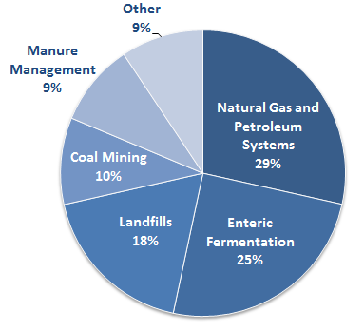

These lost methane emissions cost the oil & gas industry billions of dollars
Largest source of U.S. anthropogenic Methane Emissions
Billions of dollars in lost revenues
In fact, between $1.8 and $2 billion annually
Source: EPA, ICF

Slide 5
Case Study: Methane Detection Works
Colorado Case Study of Regulation 7
  Producers report finding 2 to 3 methane gas leaks on average, and they find at least one methane gas leak in 9-out-of-10 typical site inspections;
  90 percent of leaks detected could be easily and economically repaired within days;
  80 percent found that in the long run they are profiting, coming out even, or paying out just a little more than they are collecting in new revenue because of Colorado’s Regulation 7

Slide 6
The Center for Methane Emissions Solutions
CMES Brief:
  Win for the oil and gas industry: capturing otherwise wasted methane that can be monetized in the marketplace
  Win for the methane mitigation industry: a global industry growing fast that could produce economic growth and jobs for American companies with a robust domestic market
www.methanesolutions.org
Follow us on Twitter @nomethanewaste

