Slide 1
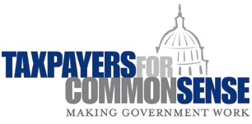
Addressing Costs of Methane Waste and Future Policy Actions
Ensuring a Fair Return to Taxpayers
October 27, 2016

Slide 2
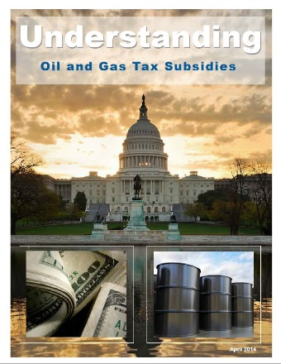
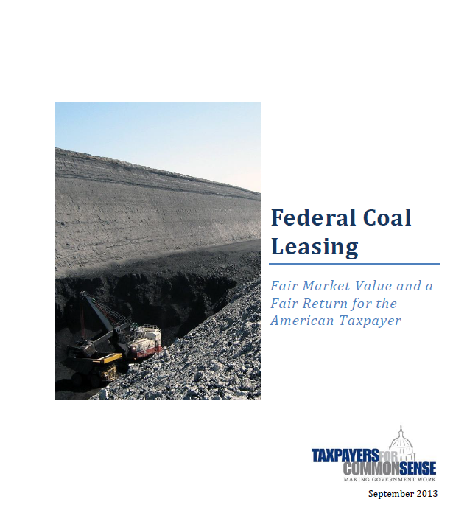
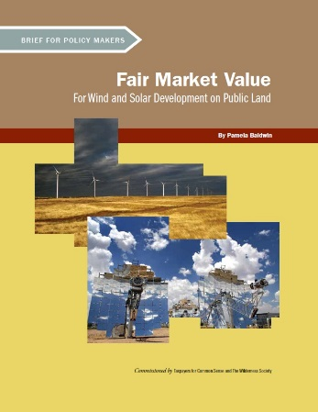
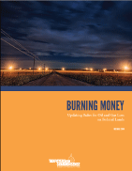
Energy and Natural Resources
Federal Coal Leasing: Fair Market Value and a Fair Return for the American Taxpayer
Fair Market Value for Wind and Solar Development on Public Lands
Understanding Oil and Gas Tax Subsidies
Burning Money: Updating Rules for Oil and Gas Loss on Public Lands
Understanding Federal Subsidies for the Biofuels & Biomass Industries

Slide 3
Fair Return to Taxpayers
Revenues from the collection of royalties from federally owned minerals represent one of the largest non-tax income sources for the federal government.
Fair and accurate collection is necessary to ensure taxpayers are receiving what they are owed.
Many of the rules governing different aspects of federal energy programs are decades old and have not kept pace with changes in energy markets and technology.
In general, federal energy development systems should be aligned to conform to a consistent set of standards that will ensure taxpayers receive adequate compensation for federal resources.

Slide 4
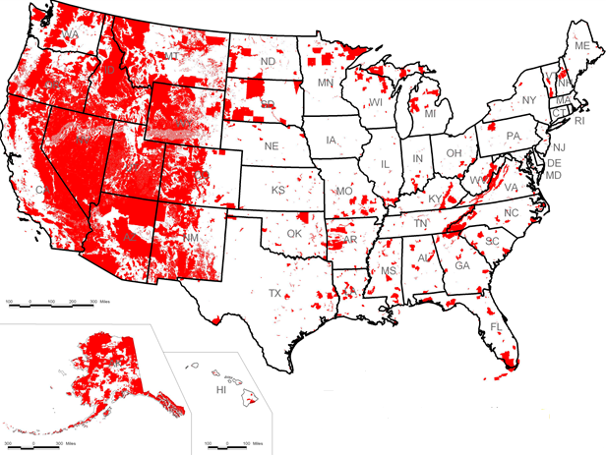
Leasing on Federal Lands
The Bureau of Land Management (BLM) within the Department of the Interior (DOI) administers mineral leasing on 245 million acres of public lands.
In FY2014, the value of oil and gas production on federal lands exceeded $27 billion.

Slide 5
Natural Gas Lost on Federal Lands
Increasing quantities of natural gas are wasted during oil and gas production.
From 2006 through 2015, oil and gas operators lost at least 189.4 bcf of natural gas, with a market value of $951.3 million.
90 percent of this lost gas did not incur a royalty.

Slide 6
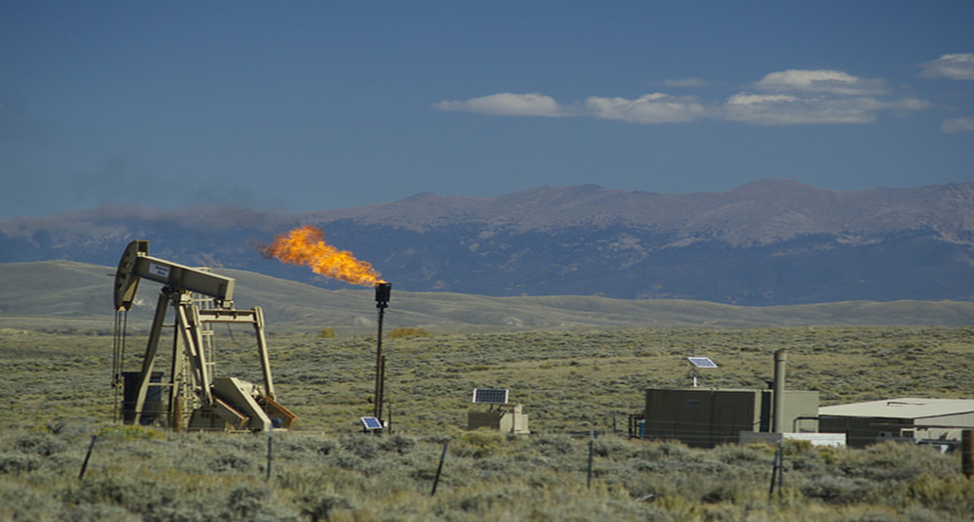
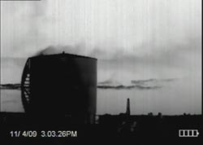
What are Sources of Methane Waste?
FLARING: the process of burning off natural gas associated with oil or gas extraction deemed to be unprofitable to capture by operators.
VENTING: Intentional or unintentional leakage of natural gas into the atmosphere.
Venting occurs at a number of points in the oil and gas development process (well completion; well maintenance; pipeline maintenance; tank maintenance; etc.).

Slide 7
BLM vs. EPA: Different Mandates
BLM is responsible for stewardship of public lands and resources (under Federal Land Policy and Management Act), and waste prevention (under Mineral Leasing Act).
BLM rule covers new and existing sources of methane emissions from oil and gas on onshore federal lands. Ninety percent of emissions in 2018 are estimated to come from existing sources.
EPA is responsible for air quality and climate pollution (under Clean Air Act).
EPA’s proposed new limits on emissions of methane and volatile organic compounds (VOC) for oil and natural gas operations will cover only new and modified methane emissions sources nationally.

Slide 8
Existing Rules at BLM on Methane Waste:
States, Tribes and federal taxpayers lose as much as $49 million annually in royalty revenue thanks to outdated federal policies.
Notice to Lessees and Operators of Onshore Federal and Indian Oil and Gas Leases (NTL-4A):
Adopted in 1980, pre-dates new techniques such as hydraulic fracturing
Largely exempted oil and gas companies from royalty payments on gas that is wasted.

Slide 9
Problems With Existing Rules (NTL-4A)
Rely on the subjective judgment of a BLM Supervisor or Authorized Officer about what is “prudent and proper” or “reasonable” to determine whether gas has been wasted and should incur a royalty.
Criticized by the Government Accountability Office for:
not providing specific instructions to operators for how to estimate the volume of lost natural gas;
providing operators with only limited guidance on how they should record volumes of natural gas in the different categories on monthly reports; and
not identifying which types of natural gas venting and flaring should be recorded on monthly reports.

Slide 10
How Does Proposed Rule Affect Taxpayers?
Good: BLM is proposing to charge a royalty on gas that is flared from wells that are connected to capture infrastructure.
Bad: No royalty charged for flaring from wells not connected to gathering infrastructure.
Good: BLM proposes to set a flaring limit of 1,800 Mcf/month/well, averaged over all producing wells on a lease.
Bad: The rulemaking needs to provide a more direct statement that all flaring above the flaring limit is subject to a royalty payment and possible penalties.
BLM should charge royalties for all flaring of associated gas from all wells. Not charging royalties reduces the incentive to install or extend gas capture equipment.

Slide 11
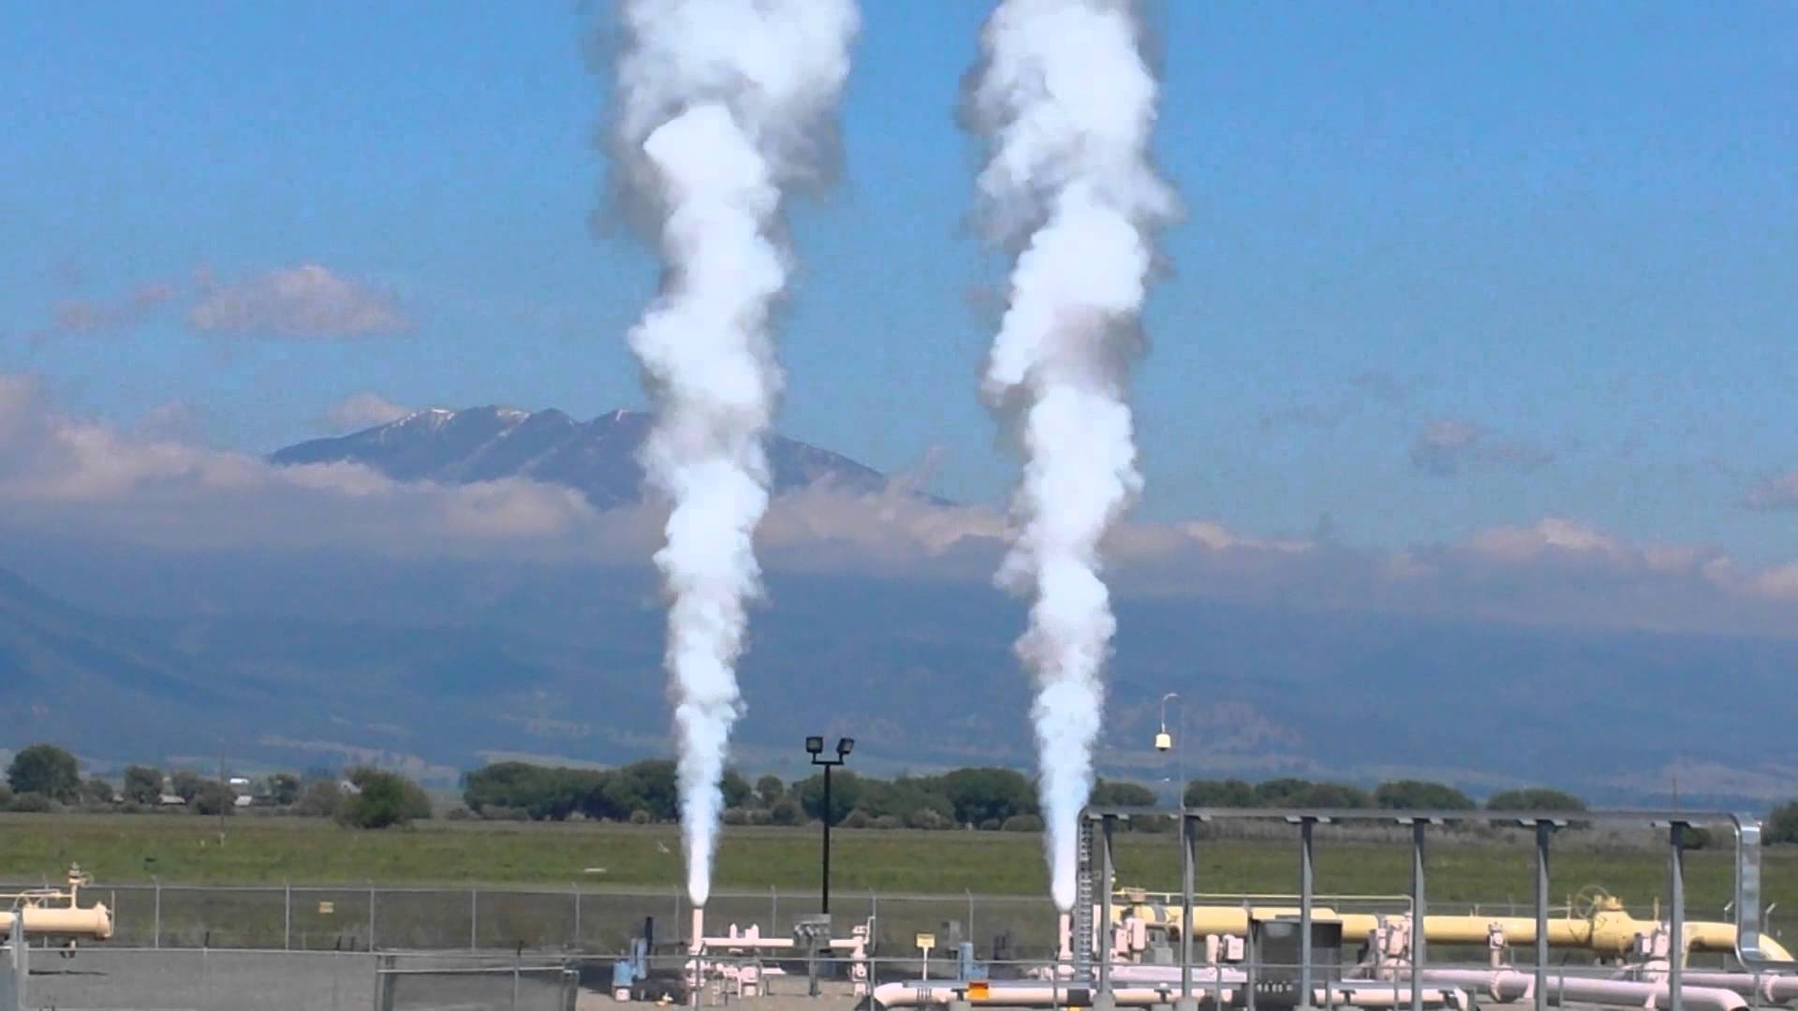
How Does Proposed Rule Affect Taxpayers?
Good: Venting prohibited, except emergencies and venting from certain equipment subject to proposed limits. Replaces all “high bleed” pneumatic controllers with “low bleed” controllers within one year.
Good: Requires use of an instrument-based leak detection and repair (LDAR) program to find and repair leaks twice a year.
Good: Modifies the existing regulation to give BLM discretion to raise the royalty rates for onshore oil and gas leases above 12.5 percent for new competitive leases, consistent with the statutory authority in the Mineral Leasing Act.
Good: Requires submission of plan with an Application for Permit to Drill to also be shared with midstream gas capture companies.
Bad: Waste minimization plan details would not be enforceable by BLM.

Slide 12
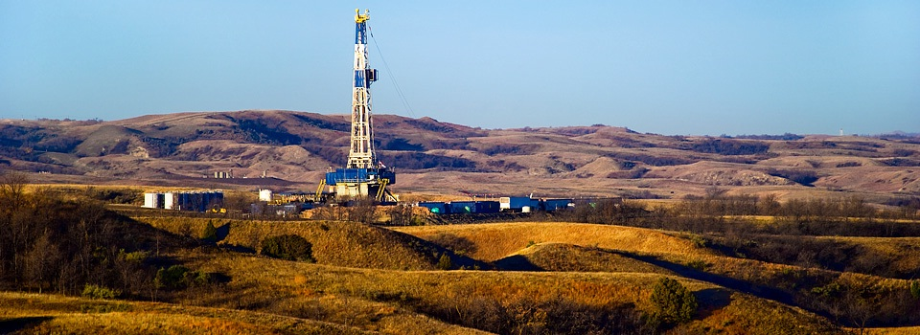
Other Concerns: Beneficial Use
Oil and gas companies are also allowed to freely use gas from a well as fuel and for other uses on a lease site, known as “beneficial use.” No royalties are paid on this gas.
From 2006 through 2015, oil and gas operators reported the “beneficial use” of 711.8 bcf of natural gas to power their equipment on federally-administered leases. This gas would have had a market value of $3.72 billion and generated $465.1 million in royalty payments.

Slide 13
Next Steps
Fair Return
In 1976, Congress passed the Federal Lands Policy and Management Act (FLPMA), which requires “the United States receive fair market value of the use of the public lands and their resources ...”
Congress further articulated BLM’s authority in the Federal Oil and Gas Royalty Management Act of 1982, which states, “Any lessee is liable for royalty payments on oil or gas lost or wasted from a lease site when such loss or waste is due to negligence on the part of the operator of the lease, or due to the failure to comply with any rule or regulation, order or citation issued under this Act or any mineral leasing law.”
For BLM - Finalize New Rule that ensures fair return for taxpayers and royalties are collected on all federally owned natural gas.
For Congress - pass legislation that ensures taxpayers receive royalties for natural gas used in wellsite operations.

